Slide 1
Crc cards
By – kanaga Manikandan solaikannan

Slide 2
What are crc cards?
CRC stands for Class, Responsibility, Collaboration.
They are used to gather a simple idea about what each class does within the project environment.
We’ll be covering on how these were used to assign responsibilities to the classes and how they aided the design and development of the software development exercise.

Slide 3

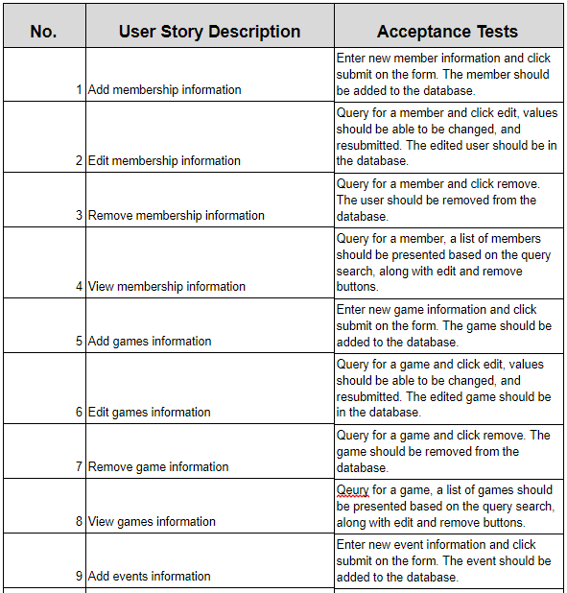
How was it created?
The team studied the requirements of this project from the user stories.
A basic outline of the classes and its functions was drawn on each team members’ minds.
All that was left was to materialise it.

Slide 4
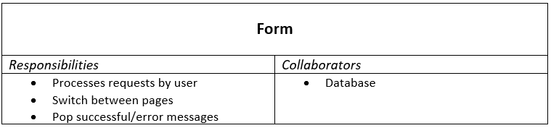
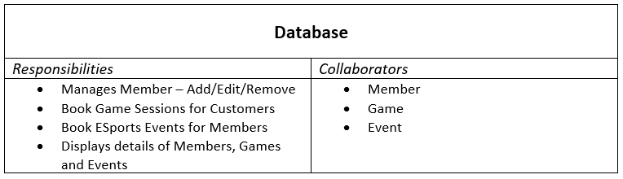
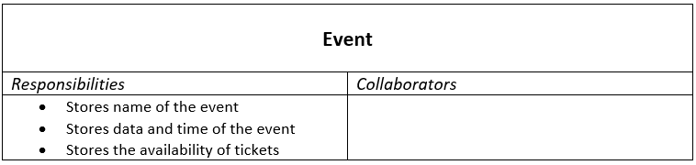
How did it assign responsibilities?
A couple of classes were formed based on the basic outline.
Responsibilities were assigned based on the functions they were planned to do.
Form Class is responsible for processing user commands and pop up messages.
Database Class is responsible for managing member details and making bookings.
Notes:
3rd point – It will also be responsible for switching between pages.
4rd point – and making game bookings for customers/members and book events for only members
The other 3 classes hold respective information that will be needed to view whenever the user decides to do so.

Slide 5
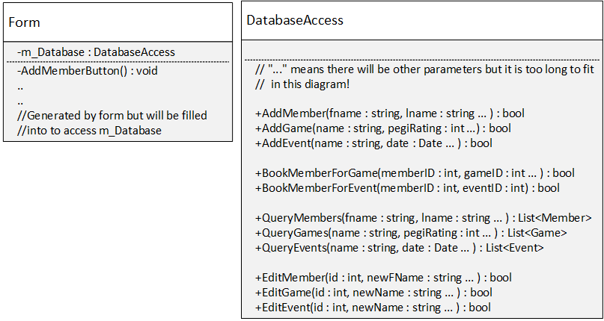
How did it aid development?
With the help of the CRC Cards, the team was able to create the class diagram.
The assigned responsibilities helped the team to understand each class better and it eased the workload.
The collaborations also helped the team to understand how each class is going to interact with another.

Slide 6
Why were they used?
CRC cards were very easy to create due to its simplistic design.
They were able to convey more info and easily understandable at the same time.
They were used so that the team will be to create the UML Class Diagram and implement classes in the software product easily.

Slide 7
references
http://www.agilemodeling.com/artifacts/crcModel.htm

